Slide 1
NB Gardens
Case Study

Slide 2
Presentation Contents
Enterprise Architecture
Creating & Querying Databases
Querying & Testing with Java
Continuous Integration

Slide 3
Enterprise Architecture
Notes:
A -dog - Intro & As-Is
S -dogg - Problems & Solutions
J -dawg - To - Be

Slide 4
Contents
What is Enterprise Architecture?
Project Brief
Initial Investigation
Business Process Modeling Notation Diagram (As-Is BPMN)
Problems & Solutions
Business Process Modeling Notation Diagram (To-Be BPMN)

Slide 5
What is Enterprise Architecture?
EA captures the business as a set of interrelated models.
Understand the Business
These models are used to analyse the business processes, and highlight areas of inefficiencies, or opportunities for improvement
Notes:
gather information about the business
understand the business goals and objectives

Slide 6
EA Consulting Project
Garden supplies company who had suffered a customer satisfaction drop over the past year.
Another group of consultants had previously been called in to address this issue.
CHRO & COO called in our consultancy team to deal with the issue

Slide 7
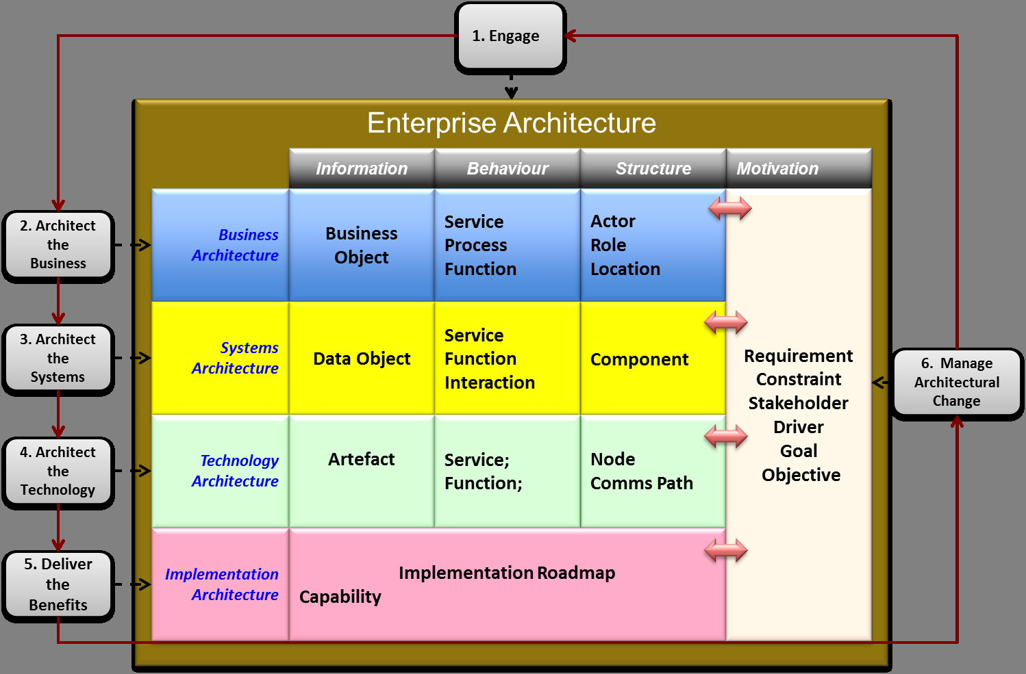
Enterprise Architecture
First Contact
Terms of Reference
Interviews
Modelling

Slide 8
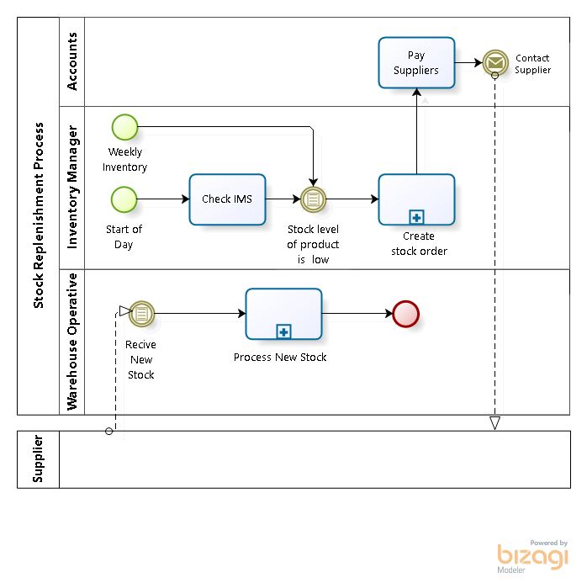
Business Modelling Current
Stock Replenishment Process

Slide 9
Business Modelling Current
Stock Replenishment Process

Slide 10
Business Modelling Current
Stock Replenishment Process

Slide 11
Problems
Customer Satisfaction
Lack of communication
Sales over satisfaction
Customer Order Fulfilment
Inefficient
Slow dispatch
Paper-based
Internal Communications
Poor IT infrastructure
Internal mail
Warehouse
Inefficient
Disorganised
Paper-based

Slide 12
Solutions
Customer Satisfaction
Customer informed of order progress
Satisfaction based pay
Customer Order Fulfilment
Sunny day path reduced
IT ordering system
Internal Communications
Integrated IT System
Discontinue internal mail
Warehouse
Handheld scanners
Document stock location

Slide 13
Business Modelling Class Diagram
Displays the business data as classes and their associations
Useful in identifying business rules
Provides a deeper insight into the business process

Slide 14
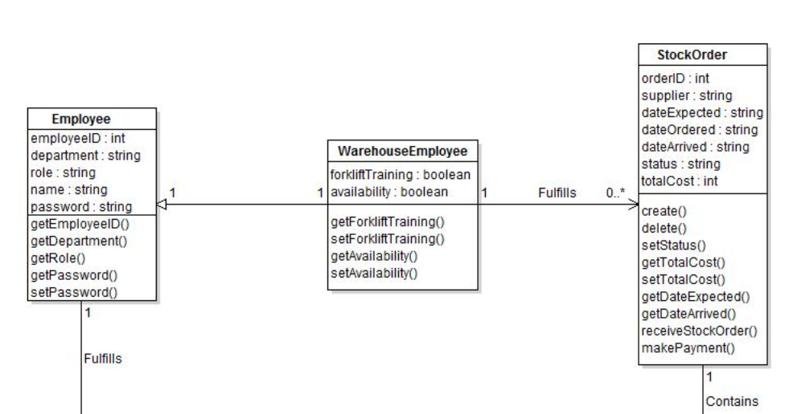
Business Modelling Class Diagram

Slide 15
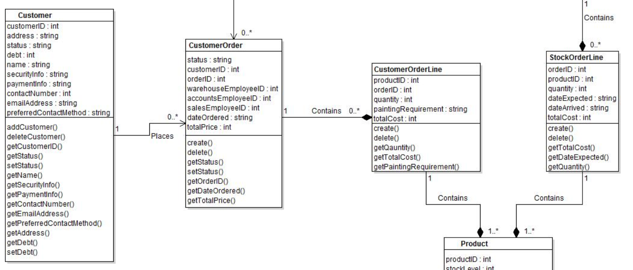
Business Modelling Class Diagram

Slide 16
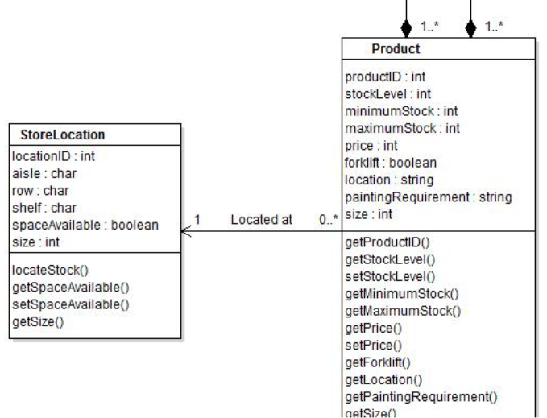
Business Modelling Class Diagram

Slide 17
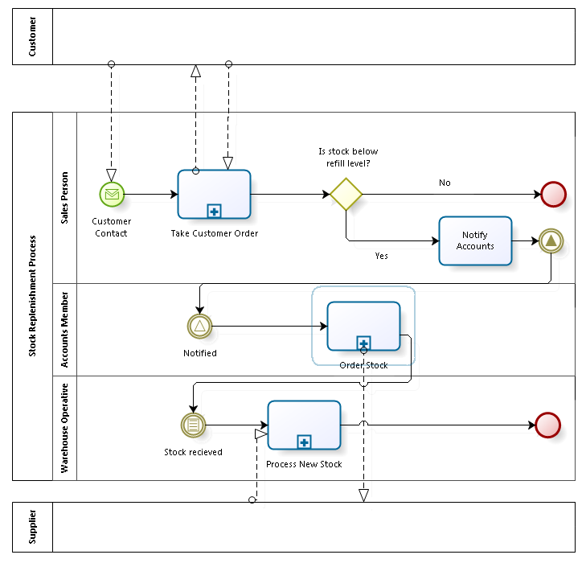
Business Modelling Future
Stock Replenishment Process
Notes:
WWJD ‘Facilitated Workshop’, details, stuff, things, Establishes a common vocabulary within the project,

Slide 18
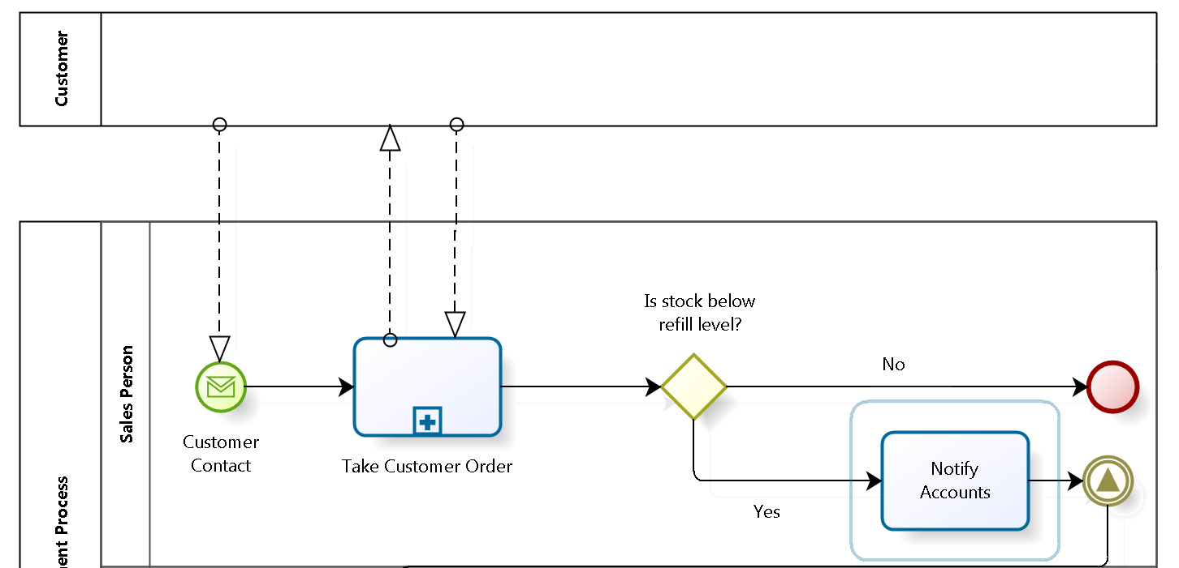
Business Modelling Future
Stock Replenishment Process

Slide 19
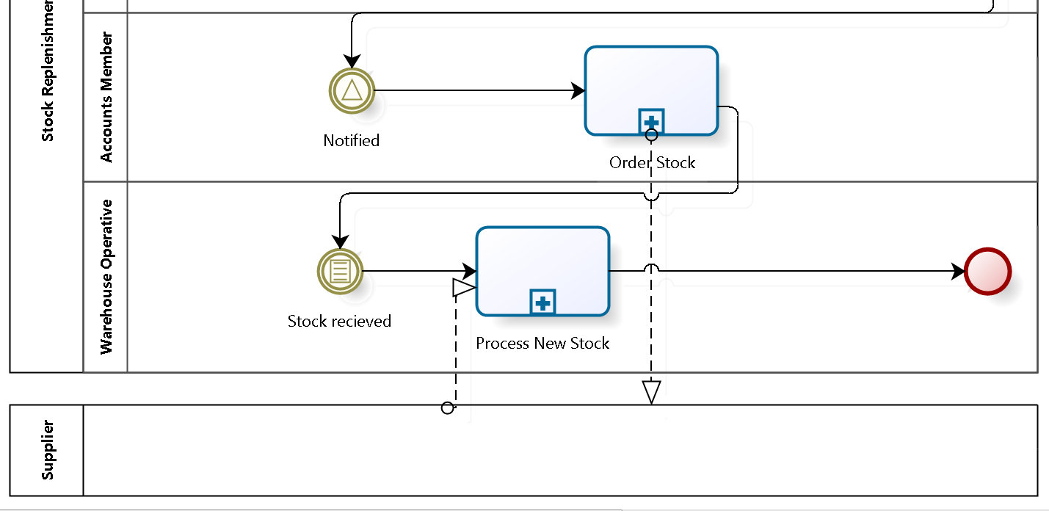
Business Modelling Future
Stock Replenishment Process

Slide 20
Databases

Slide 21
Introduction
Relational vs Non-Relational Databases
Database Design
Database Creation (Oracle & MongoDB)
Database Security (Oracle & MongoDB
Database Querying (Oracle & MongoDB)

Slide 22
Databases
Relational databases
Oracle SQL
Apache Hive
Non-relational databases
MongoDB
Elasticsearch
Apache Cassandra

Slide 23
Database Comparison
Database Type | Oracle SQL | MongoDB
Structure | Highly Structured | Eventual consistency
Querying | Powerful querying language | MongoDB CLI
Availability | Database stored on a single server | Distributed Databases

Slide 24
Advantages of Oracle SQL
Store data efficiently in predefined schemas
Uses structured query language (SQL) for database access
Linking tables with keys limits data duplication

Slide 25
Advantages of MongoDB
Better able to handle large datasets and streaming data
Producing replicas of data to prevent data loss
If schemas need to change new rows can be added to new datasets without affecting old ones

Slide 26
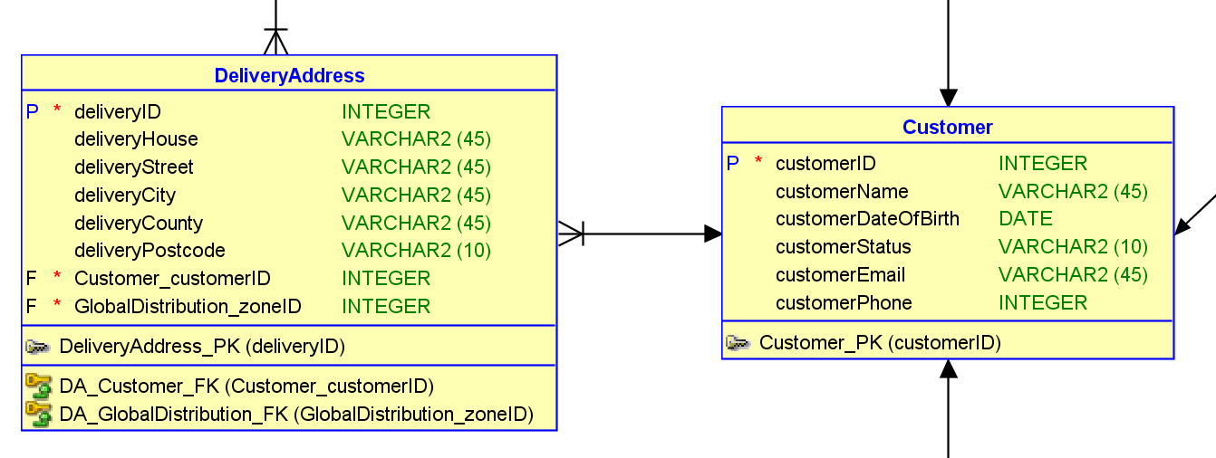
Relational Database
As a member of the Accounts team, I want to store a customer’s delivery address on the system so that orders can be delivered directly to the customer
Identify the entity
Identify the attributes
Identify the primary key
Identify the relationships
Identify the cardinality
Draw a draft
Map the attributes
Refine the Entity Relationship Diagram
has

Slide 27
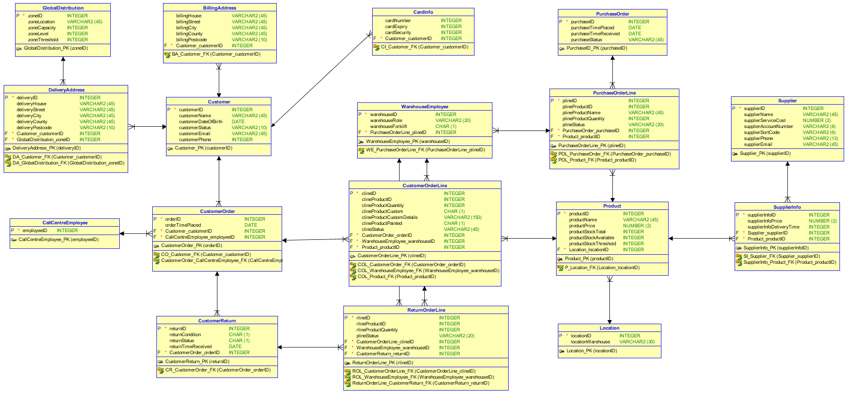
Relational Database

Slide 28
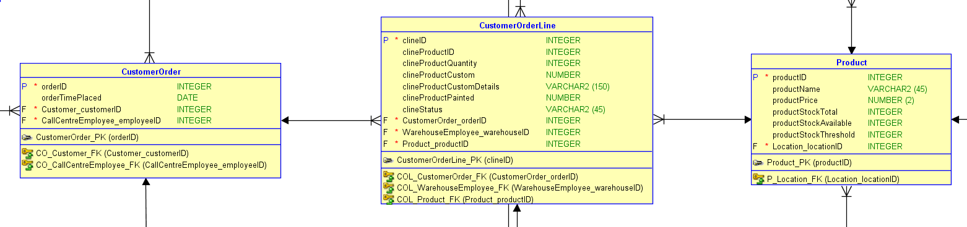
Relational Database

Slide 29
Non-Relational Database
productID : 1,
productPicture : “url:pic1.co”,
productDescription : “Standard Gnome for those starting out on their journey to gnome enthusiasm“,
productCustom : {
head : ["yellow", "brown", "orange"],
shirt : ["blue", "green", "yellow"],
trousers : ["green", "yellow", "red"],
shoes : ["pink", "green", "blue"]
}
productID : 10,
productPicture : "url:pic10.co",
productDescription : "Fine oak table, perfect for hosting summer dinner parties"})
Product
- productID
- productCustom
- productDescription
- productPicture

Slide 30
Oracle: Create
CREATE TABLE Customer
(
customerID INTEGER NOT NULL ,
customerName VARCHAR2 (45) ,
customerDOB DATE ,
customerStatus VARCHAR2 (45) ,
customerEmail VARCHAR2 (45) ,
customerPhone INTEGER ,
PaymentDetails_cardNumber VARCHAR2 (16) NOT NULL ,
PaymentDetails_cardSecurity VARCHAR2 (3) NOT NULL
) ;
ALTER TABLE Customer
ADD CONSTRAINT Customer_PK
PRIMARY KEY ( customerID ) ;
ALTER TABLE Customer
ADD CONSTRAINT C_PaymentDetails_FK
FOREIGN KEY ( PaymentDetails_cardNumber, PaymentDetails_cardSecurity )
REFERENCES PaymentDetails ( cardNumber, cardSecurity ) ;

Slide 31
MongoDB: Create
db.Customer.ensureIndex ({customerID : 1}, {unique : 1})
db.Customer.insert ({customerID : 800002,
customerName : "Oliver Heald",
customerDateOfBirth : new Date (1940, 02, 18),
customerEmail : "heald@email.com",
customerPhone : 4454370987976,
customerStatus : "hold",
customerCard : {cardNumber : 2345678901234567,
cardExpiry : "05/17",
cardSecurity : 234,
cardBillingID : 810002 }})
customerAddress [{addressID : 810002,
addressHouse : "11",
addressStreet : "Street" ,
addressCity : "Letchworth Garden City",
addressCounty : "Hertfordshire",
addressPostcode : "SG6 OH1"}
{addressID : 810003,
addressHouse : "12",
addressStreet : "Street",
addressCity : "Letchworth Garden City",
addressCounty : "Hertfordshire",
addressPostcode : "SG6 OH1"}})

Slide 32
Oracle & MongoDB: Secure
CREATE ROLE Accounts IDENTIFIED BY password;
GRANT SELECT ON Customer to Accounts;
GRANT INSERT ON Customer to Accounts;
GRANT UPDATE ON Customer to Accounts;
use admin
db.createUser (
user : "Accounts",
pwd : "password",
roles : [{
role : "readWrite",
db : "NBGardens",
collection : "Customer"
}]})
db.runCommand ({
updateRole : “Accounts",
privileges : [{
resource : {
db : “NBGardens",
collection : "Customer"},
actions : ["find", "update", "insert", "remove"]
}]})
Oracle
MongoDB

Slide 33
Oracle: Query
Product
Customer Order
Customer Order Line
Product ID | Product Name | Product Price
1 | Blue Gnome | 100
2 | Green Gnome | 100
3 | Jacuzzi | 3000
4 | Birdbath | 500
5 | Red Bench | 300
Order ID | Customer ID
1 | 2
2 | 5
3 | 3
4 | 3
5 | 2
Order ID | Product ID | Product Quantity
1 | 5 | 2
4 | 2 | 1
3 | 3 | 1
4 | 5 | 2
5 | 3 | 5
Order ID: 3 Product ID: 3 Quantity: 1 Product Price: 3000 Total: 3000
Order ID: 4 Product ID: 2 Quantity: 1 Product Price: 100 Total: 100
Order ID: 4 Product ID: 5 Quantity: 2 Product Price: 300 Total: 600
DECLARE
CURSOR cursor IS SELECT
CustomerOrder.customerOrderid,
CustomerOrderLine.productID,
CustomerOrderLine.clineQuantity,
Product.productprice
FROM Customer
JOIN Customerorder ON CustomerOrder.customerID = Customer.customerID
JOIN Customerorderline ON CustomerOrderLine.clineOrderID = Customerorder.orderID
JOIN Product ON Product.productID = customerorderline.productid
WHERE
Customer.customerid = 5;
order_ID CustomerOrder.orderID%type;
product_ID CustomerOrderLine.productID%type;
quantity CustomerOrderLine.clineQuantity%type;
product_Price product.productPrice%type;
BEGIN
OPEN cursor;
LOOP
FETCH cursor into order_ID, product_ID, quantity, product_Price;
IF cursor%found then
dbms_output.put_line('Order ID: '||order_ID ||
' Product ID: ' || product_ID ||
' Quantity: '|| quantity ||
' Product Price: '|| product_Price||
' Total: ' || quantity * product_Price);
ELSE exit;
END if;
END loop;
END;
/

Slide 34
MongoDB: Query
> db.Customer.find().pretty()
> db.Customer.find({customerID:800001},{customerID:1}).pretty()
> db.CustomerOrder.find({ products : {$all : [
{ $elemMatch : {productQuantity:1}},
{ $elemMatch : {productQuantity:1}}]}},
{ "products.productID.$":1, _id:0}).pretty()
“products” : [
{
“productID” : 600003,
“productQuantity” : 1,
“productStatus” : “packed”
“warehouseID : 303
}
]

Slide 35
Querying & Testing with Java

Slide 36
Contents
Design
Querying
Demo
Testing

Slide 37
Java Project Design
Task
To develop a java program for the inventory management system of NBGardens
Requirements
Creating a class diagram
Connecting to the databases
Having different access for different roles
Returning the relevant information for each role

Slide 38
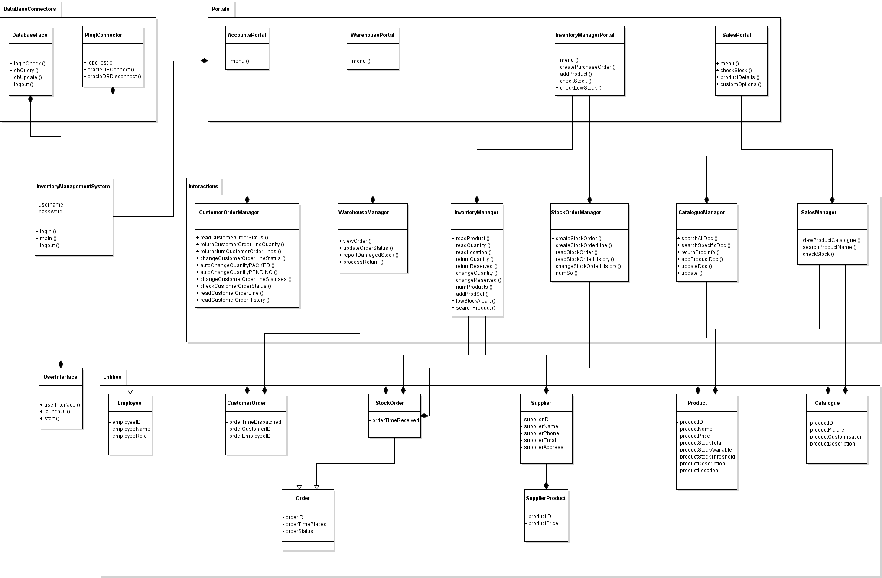

Slide 39
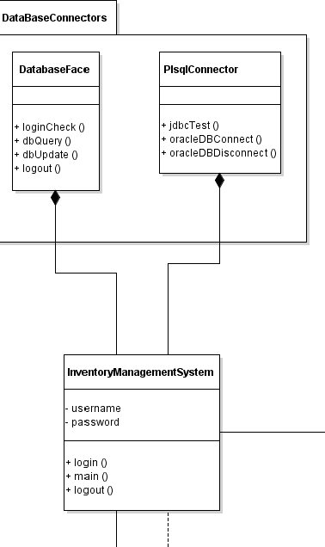
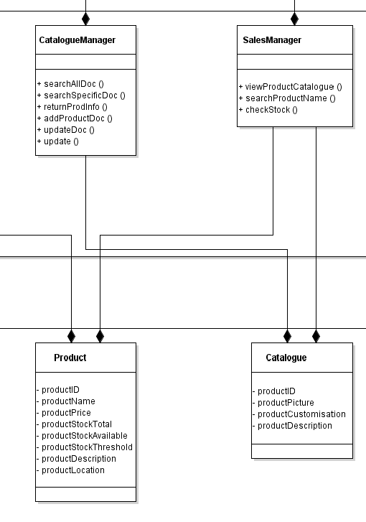

Slide 40
Querying Databases
MongoDB
Situated within the catalogue class
Requires opening and closing the connection for each method
Oracle SQL
Within its own class as the connection can be opened and returned
Used by the Accounts, Warehouse, Sales and Inventory Manager classes

Slide 41
Querying Databases
Oracle SQL
Create the string
Return the string
Pass the string to the execute method
Return the information
MongoDB
Choose the collection
Choose the document
Choose the values
Return the …

Slide 42
Inventory Management System Demo

Slide 43
Testing
Unit testing implemented with JUnit
Unit testing framework for Java
From a family of frameworks known as xUnit
Can be run automatically

Slide 44
Automation Testing
Advantages compared to manual testing
Automated tests run significantly faster than manual tests
Less investment in human resources are required
More reliable than manual testing, the exact same actions are performed every run
The speed of automation test allows for more advanced tests to be written

Slide 45
Tests
21 system requirements
7 test suites covering different portals of system
Comprised of 42 tests
Positive and negative test for each requirement

Slide 46
Test Driven Development
Software development process that focuses on creating tests first and writing code to pass tests
Write tests based on requirements & specifications
All tests initially fail
Write code to pass test
Repeat process
Agile development using short cycles

Slide 47
Continuous Integration

Slide 48
Introduction
To introduce the concept of Continuous Integration (CI).
To introduce the tools that are used during the CI project.
To visualise how the tools are connected and utilised.
To understand the advantages of CI.

Slide 49
What is CI?
CI is a development practice that requires developers to integrate code into a shared repository several times a day. Each check-in is then verified by an automated build, allowing teams to detect problems early.
To detect errors quickly, and locate them more easily.
Can utilise more time in building features.

Slide 50
Principles of CI
Maintain a single source repository
Automate the build
Make your build self-testing
Every commit should build on an integration machine
Keep the build fast
Test in a clone of the production environment
Make it easy for anyone to get the latest executable
Everyone can see what’s happening
Automate deployment

Slide 51
JIRA
Workflow management system
Bug tracking
Issue tracking
Project Management Functions

Slide 52
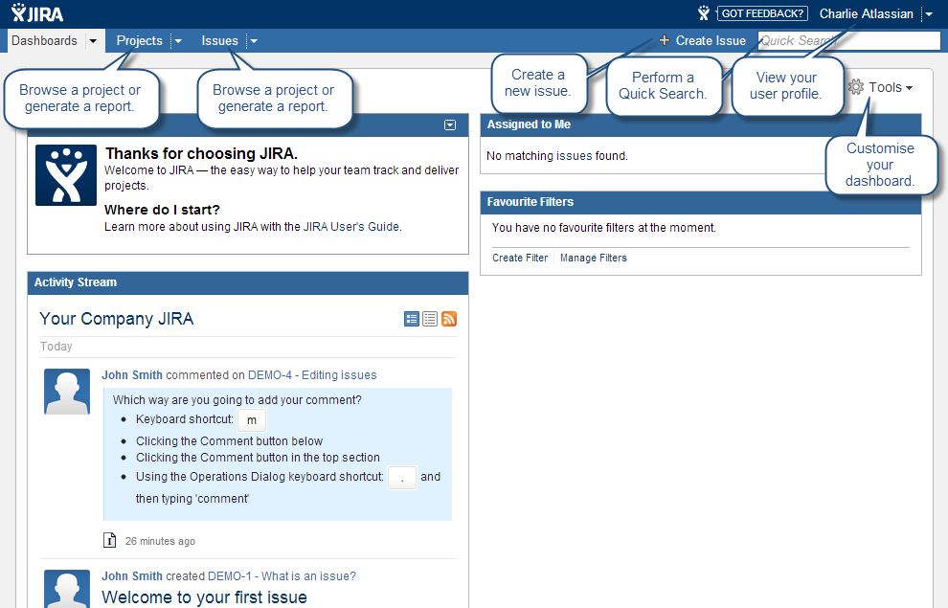

Slide 53
Vagrant
Vagrant is a tool for building complete development environments.
Controlled by a single consistent workflow which helps to maximize the productivity and flexibility

Slide 54
Docker
Function
Separates applications from infrastructures using container technology
Benefits
Scalable
Portable
Density
Deployment

Slide 55
Docker Components
Core Components
Docker Daemon
Docker Engine runs on the host machine
Docker Client
Interact with the Daemon
Workflow Components
Docker Image ( Holds the environment & app)
Docker Container(Created from images, start, stop, move and delete)
Docker Registry (Public & Private repository used to store images)
Dockerfile (Automates image construction)

Slide 56
Git
An open source distributed version control
Used to make sure all members of a group have access to the same code and can work on it at the same time
Can roll back to previous versions of the code

Slide 57
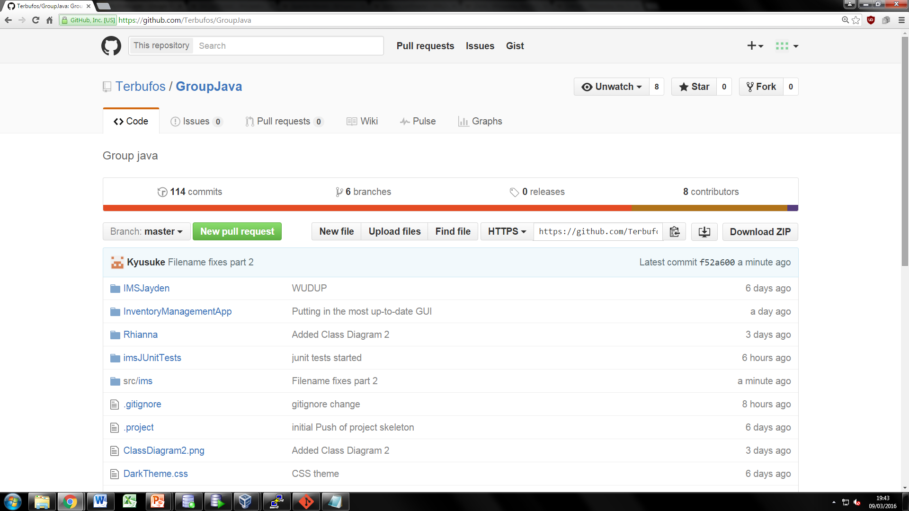
Git

Slide 58
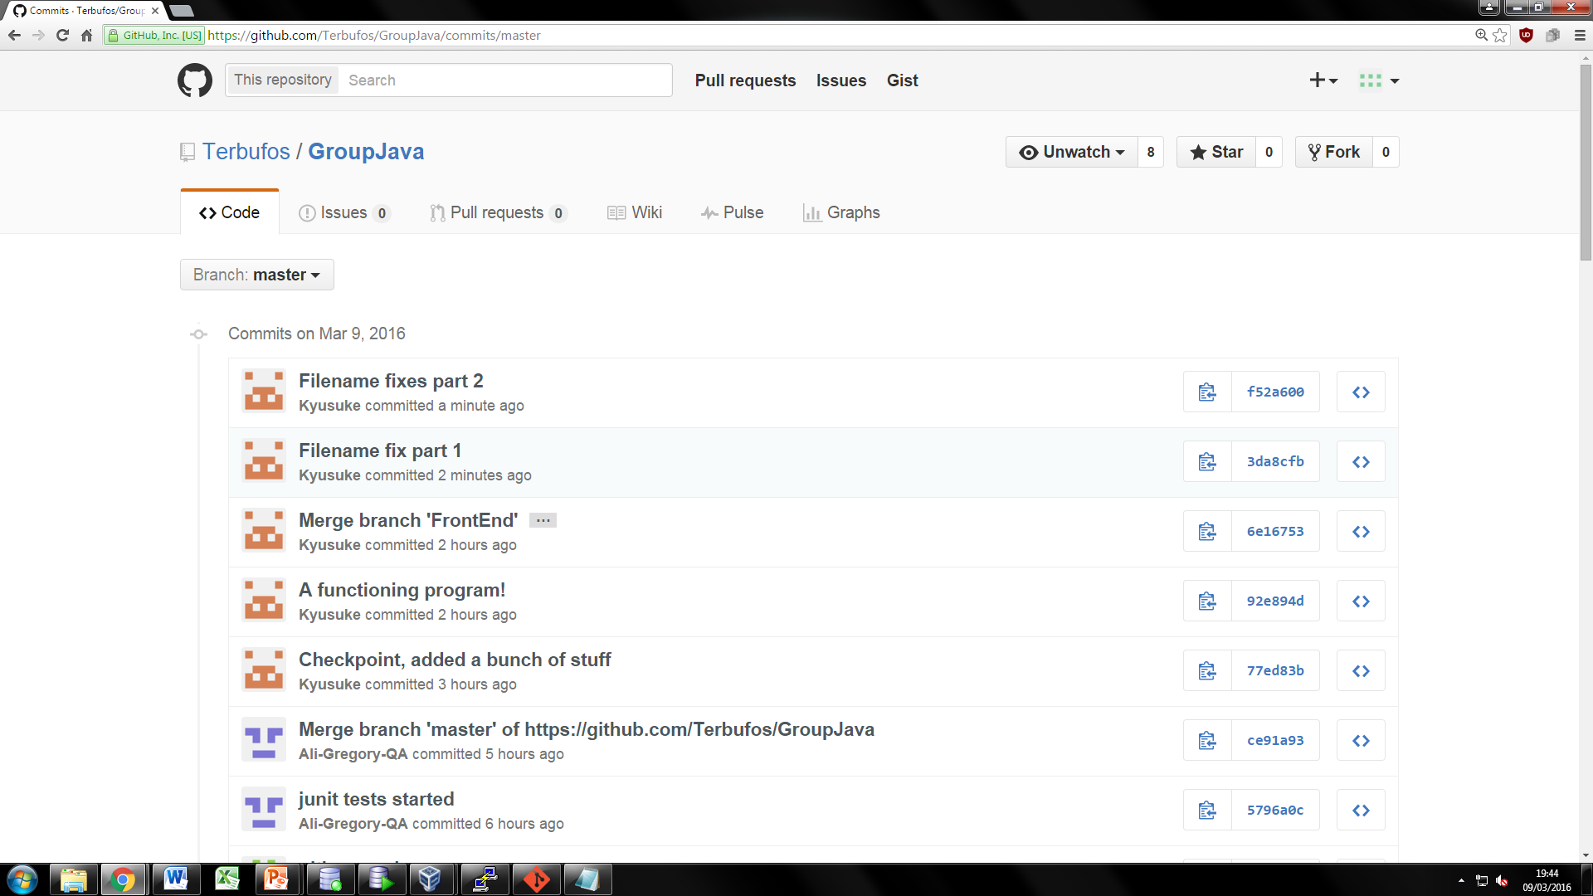
Git

Slide 59
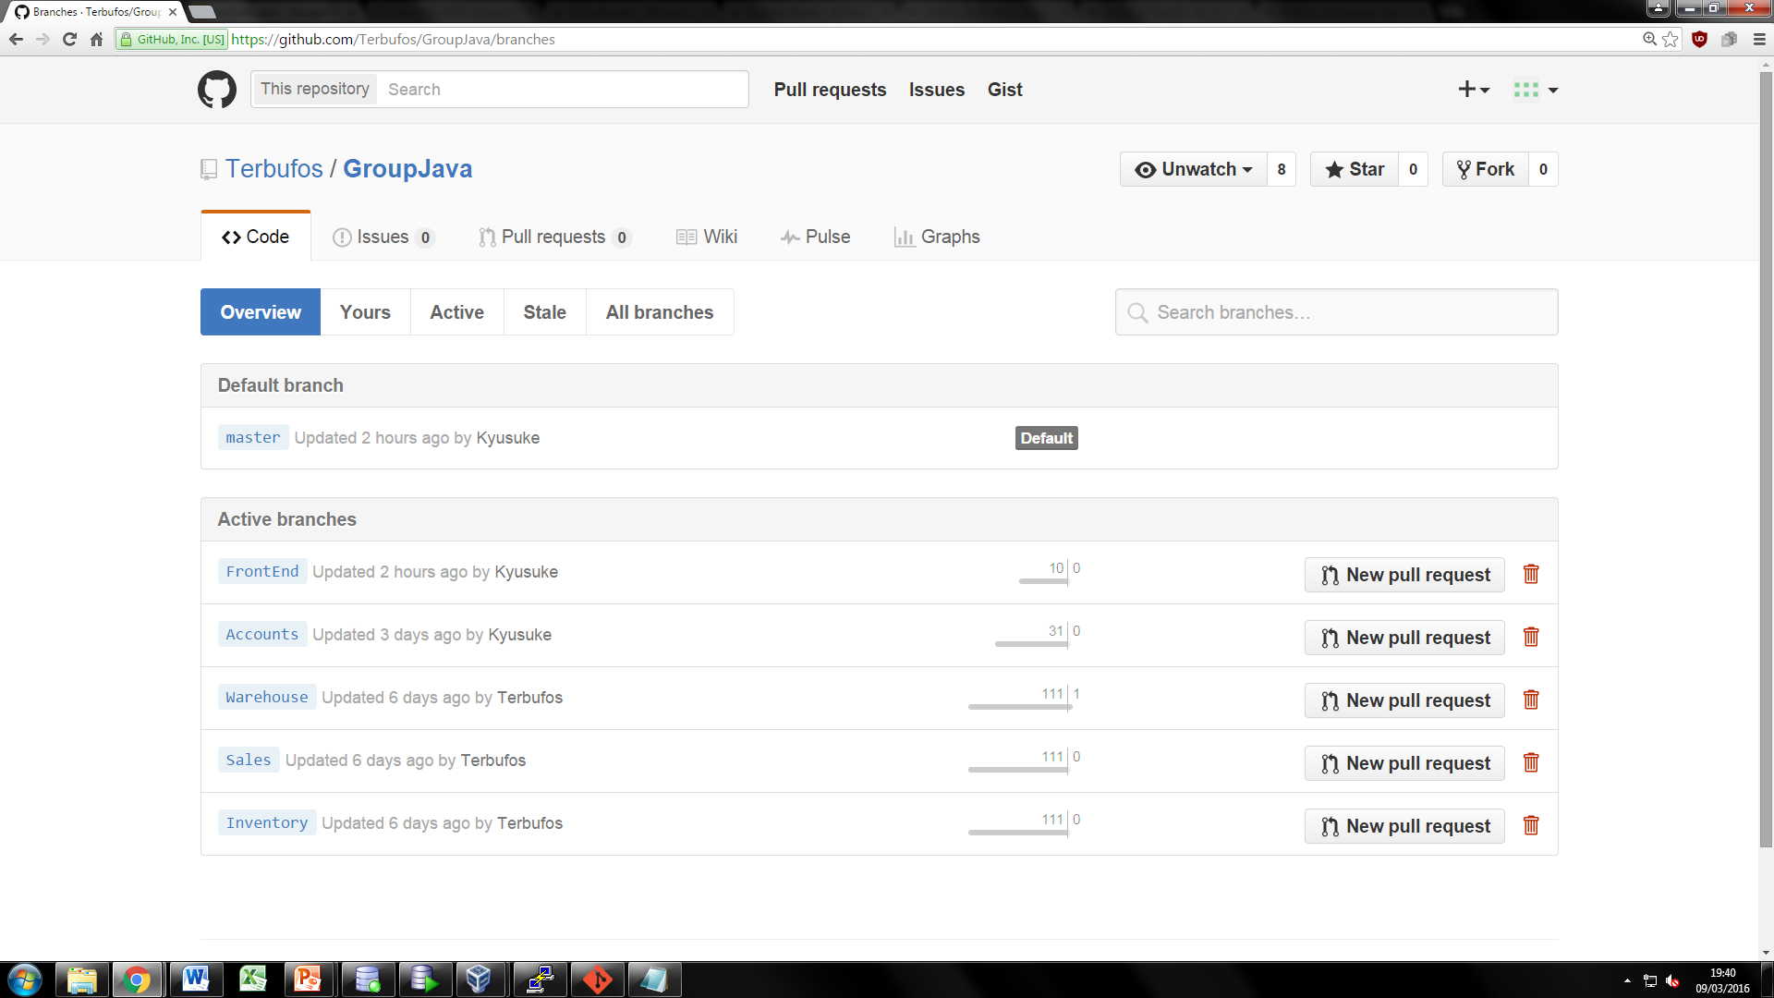
Git

Slide 60
Jenkins
An open source automation server
Built with Java
It supports building, testing, deploying and automating virtually any project
Periodically checks for updates from a repository such as Git
Pulls updates and then pushes them onto a build automation tool such as Maven
Maven would then build this code and push it onto a testing tool, e.g. JUnit

Slide 61
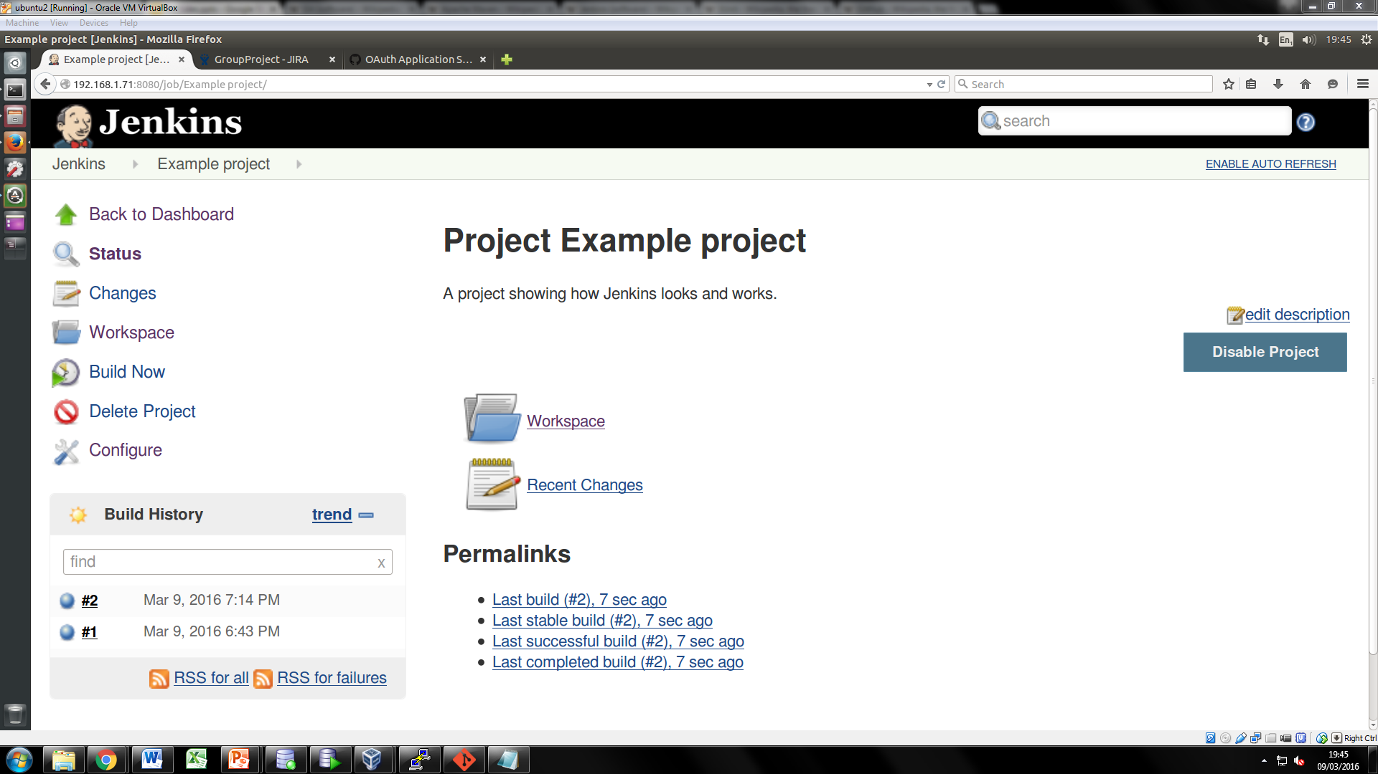
Jenkins

Slide 62
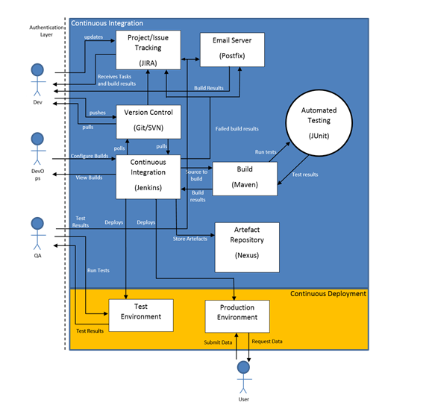
Pipeline

Slide 63
Advantages VS Limitations
Advantages | Limitations
Early detection of bugs | Setup time of CI system
Early detection of integration issues
Early detection of failed unit tests / self testing code
Automate deployment
Developers can be held accountable for any errors made

Slide 64
Final Summary
Enterprise Architecture
Creating & Querying Databases
Querying & Testing with Java
Continuous Integration

Slide 65
Thank you
Any Questions?

